Slide 1
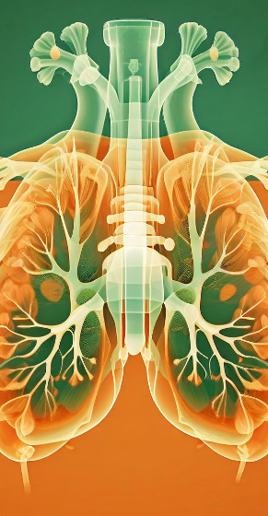
GROUP H
PNEUMONIA DETECTION: A DEEP LEARNING APPROACH
Deep learning model to detect pneumonia from X-rays using convolutional neural network and deployed a web application for future predictions.
Group Members:- Abisheak Dhanabal
Dona Biju
Jerin Thomas
Sanika Sabeesh
Sneha Sujatha

Slide 2
Problem Statement and Significance
Challenge
Pneumonia diagnosis remains challenging, especially in resource-limited settings.
IMPACT Accurate detection can significantly improve patient outcomes and reduce healthcare costs.
Innovation
Deep learning offers a promising solution for automated, reliable pneumonia detection.

Slide 3
DATASET OVERVIEW
Kaggle Link: https://www.kaggle.com/datasets/paultimothymooney/chest-xray-pneumonia
CLASSES
NORMAL
PNEUMONIA
Training Data Class Counts
PNEUMONIA (Class 0): 3875 samples
NORMAL (Class 1): 1341 samples
Github Link:- https://github.com/Jerin-T/pneumonia_detection_system

Slide 4

DATASET PREPROCESSING
Image Shape Extraction
01
Image Shape Extraction
02
Training Data Class Counts:
PNEUMONIA: 3875 samples
NORMAL: 1341 samples
Test Data Class Counts:
PNEUMONIA: 390 samples
NORMAL : 234 samples
Validation Data Class Counts:
PNEUMONIA: 8 samples
NORMAL: 8 samples
Extracted and resized images to a target size of 150x150 pixels.
Ensured all images were converted to RGB format.
Collected and printed image shapes for Pneumonia and Normal classes in training and validation datasets.

Slide 5

Class Occurrences:
Counted the number of occurrences of each class in the training, test, and validation datasets.
Class Imbalance Handling:
Calculated class weights to address the class imbalance:
Class Weights:
Pneumonia: 1.94
Normal: 0.67
Utilized these weights during model training to balance the influence of each class.

Slide 6
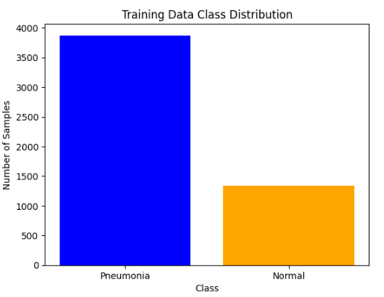
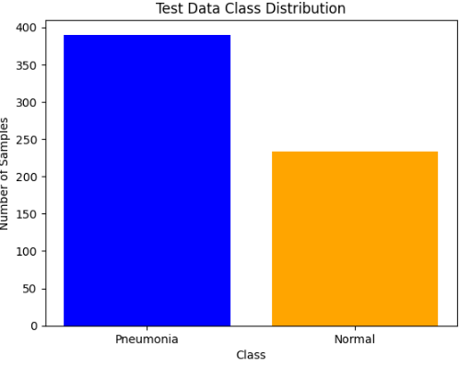
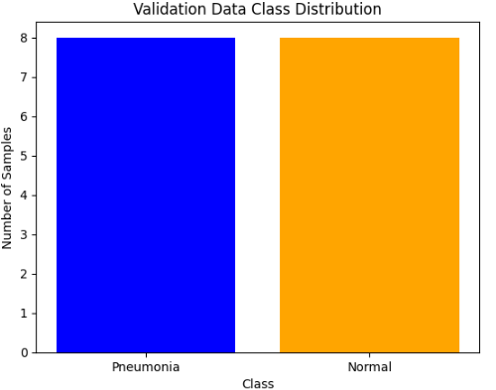
DATA VISUALIZATION

Slide 7
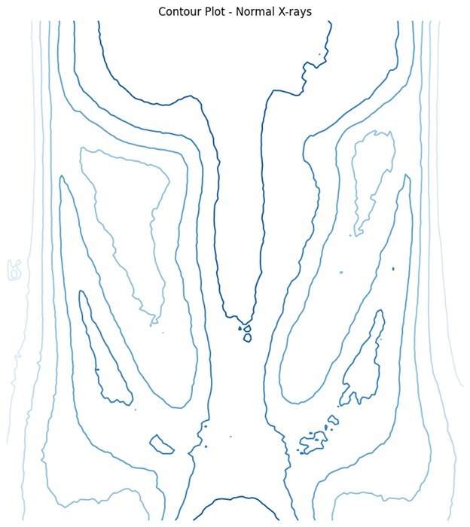
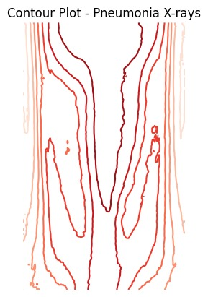
Counter plots of Normal and Pneumonia X-Rays

Slide 8
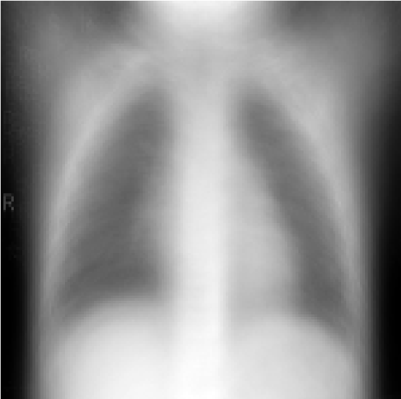
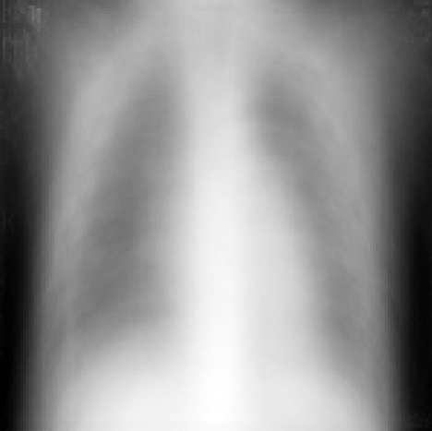
AVERAGE NORMAL X-RAY AVERAGE PNEUMONIA X-RAY

Slide 9
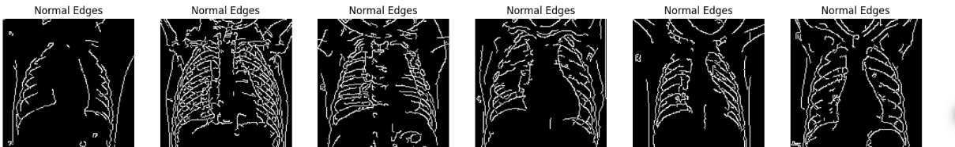
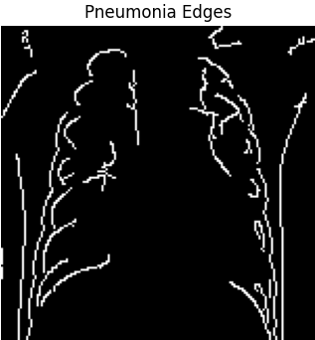

Slide 10
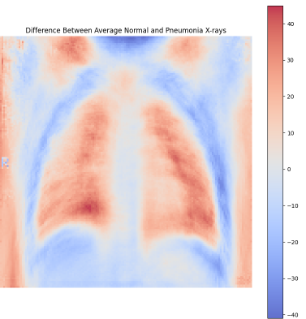
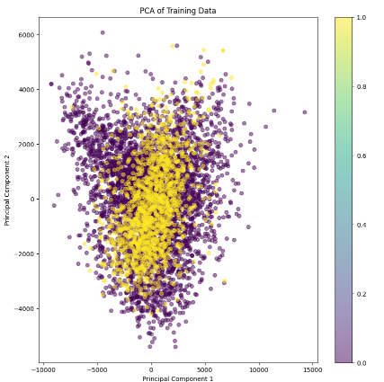

Slide 11

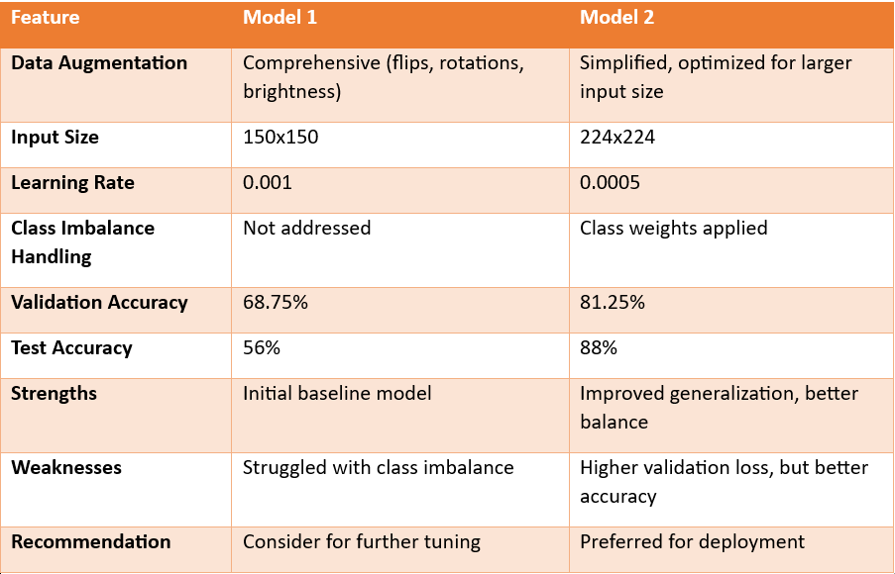
Comparison of Two VGG19 Models for Pneumonia Detection

Slide 12
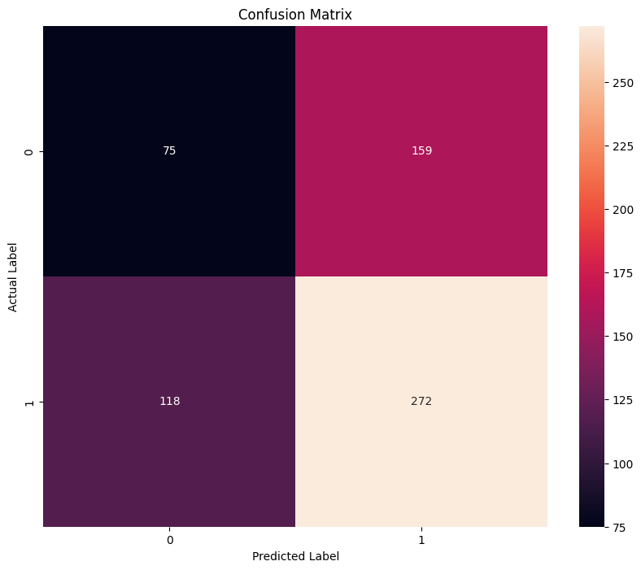
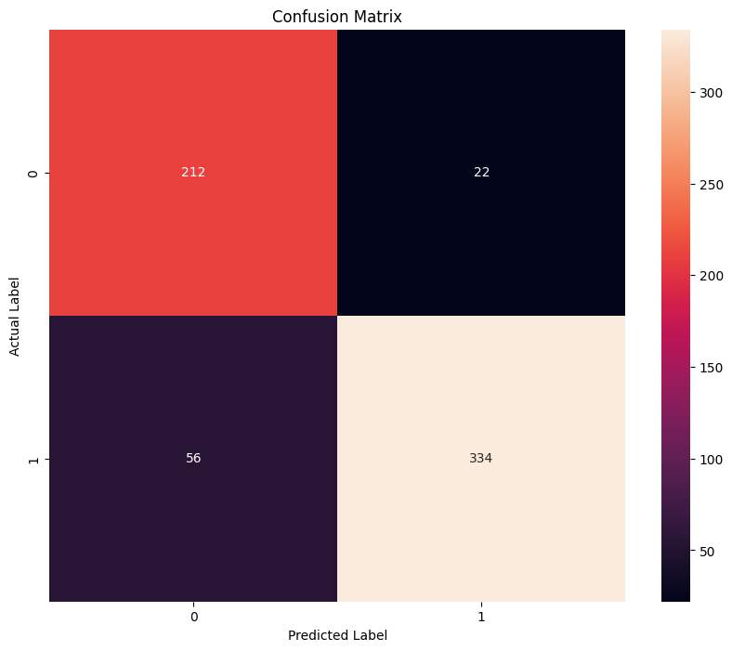
Classification report of VGG19 Models Model 1 Model2

Slide 13

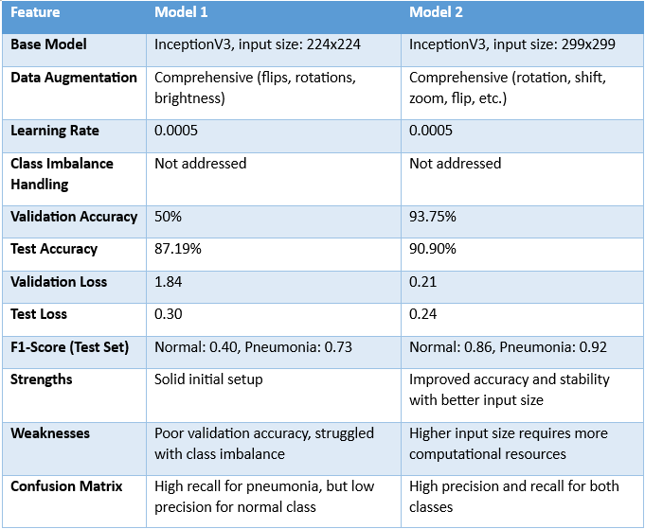
Comparison of two Inceptionv3 models.

Slide 14
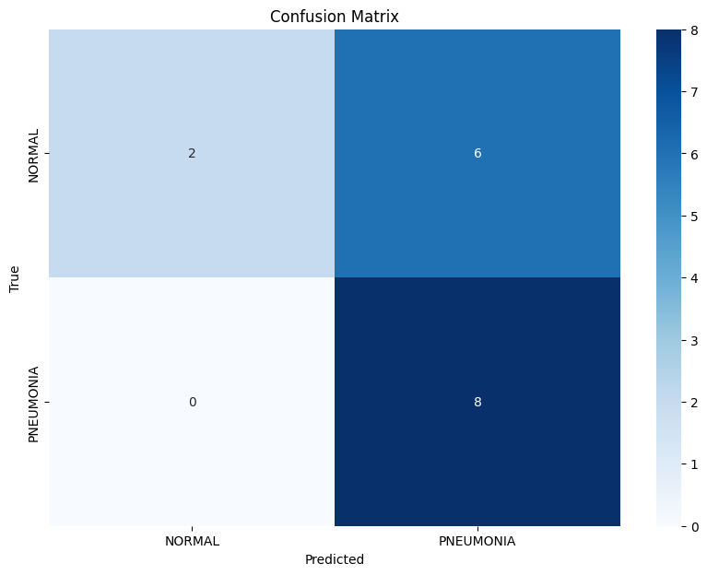
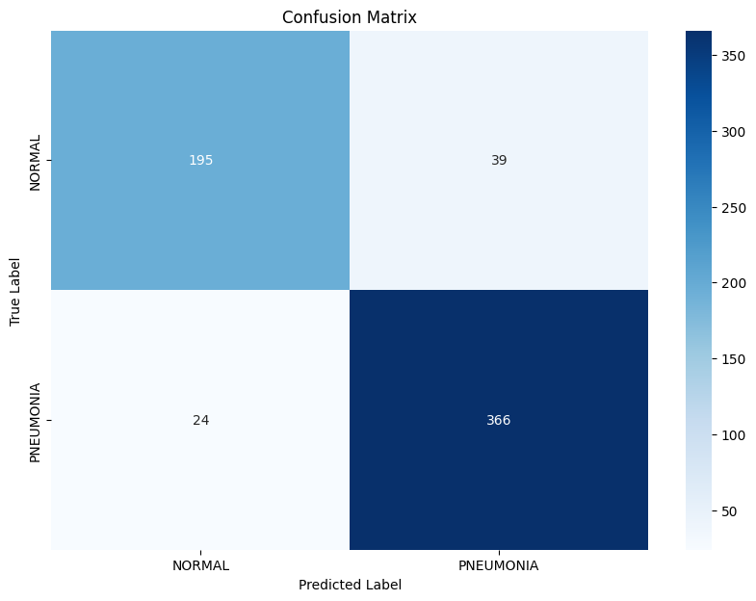
Classification of two Inceptionv3 Models
Model1 Model2

Slide 15
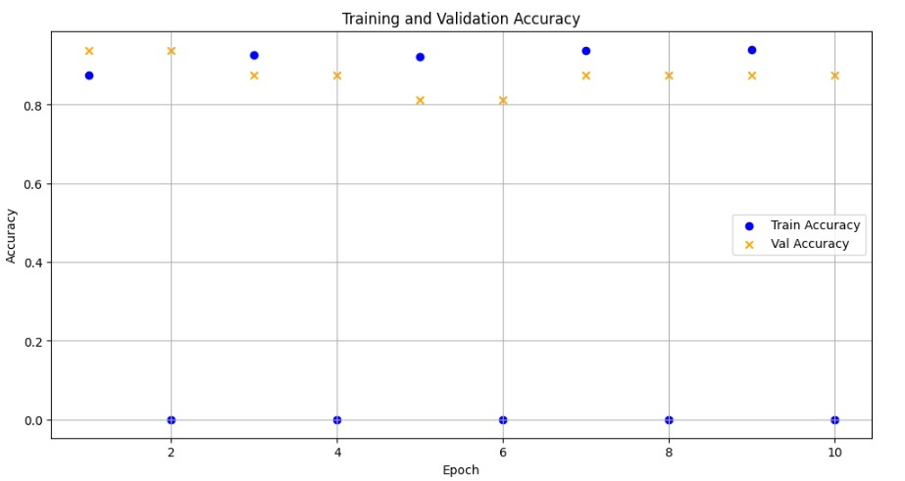
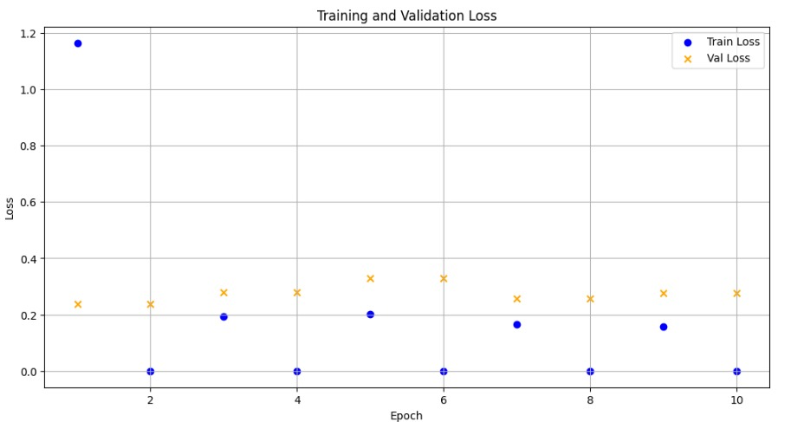
Training and Validation Accuracy vs Loss

Slide 16

Why InceptionV3?
Superior Performance and Metrics
Data Augmentation: Comprehensive (rotation, shift, zoom, flip)
Input Size: 299x299 pixels - Captures finer details, improves accuracy
Learning Rate: 0.0005 - Balanced learning, avoids overfitting
Validation Accuracy: 93.75%
Test Accuracy: 90.90%
F1-Scores: Normal: 0.86, Pneumonia: 0.92
Validation Loss: 0.21, Test Loss: 0.24
Strengths: High accuracy, stable generalization
Weaknesses: Higher input size requires more resources

Slide 17
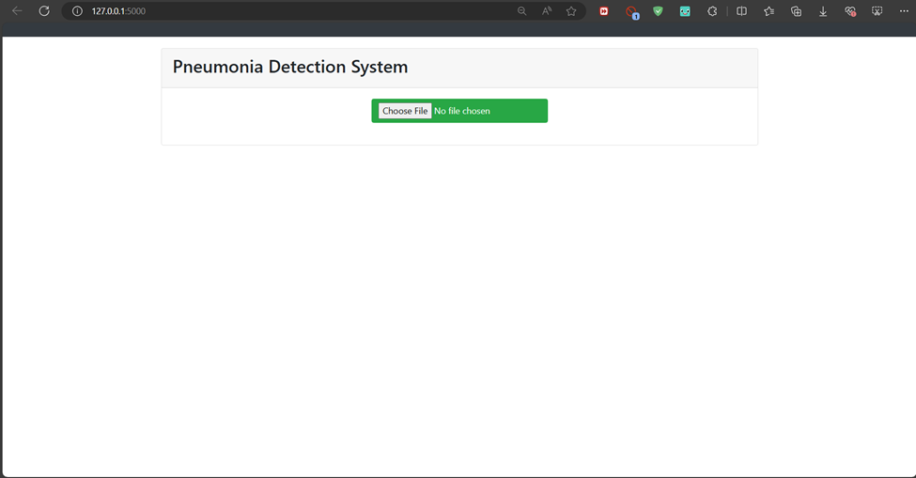
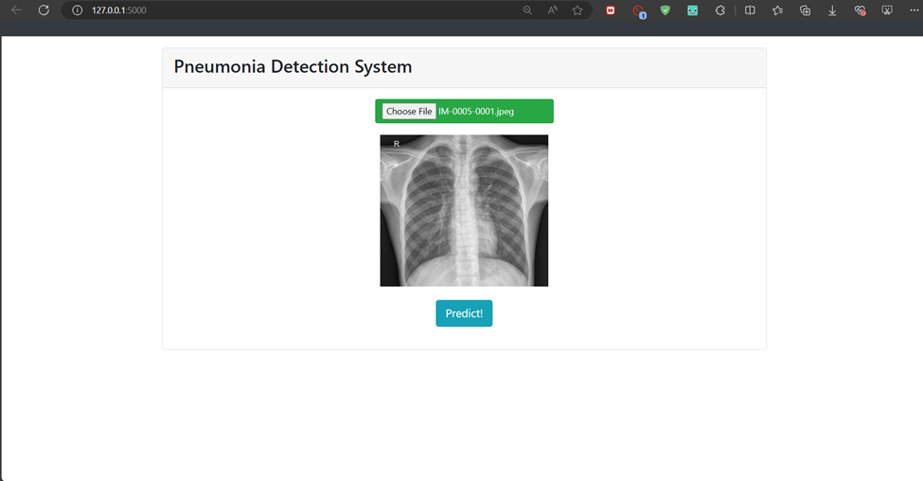
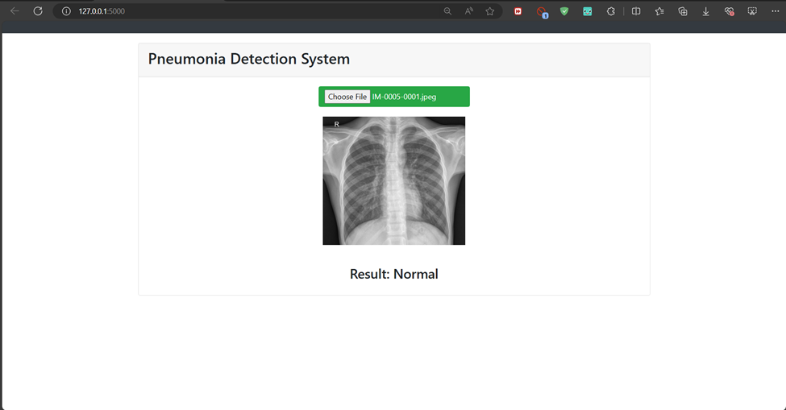
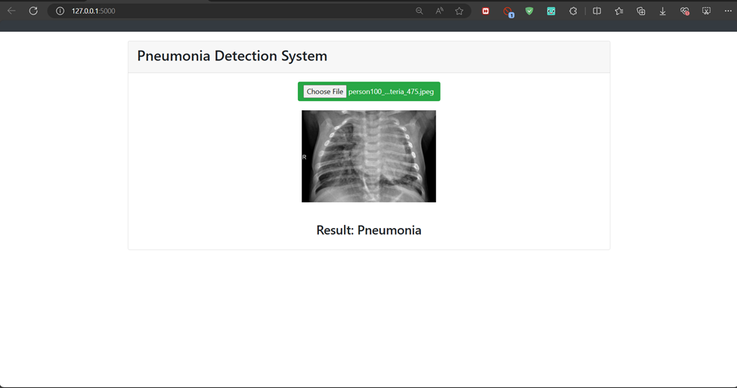
Sample outputs of our web application

Slide 18


LIVE DEMO!

Slide 19
Thank You!!!

